Slide 1
Contextual Safeguarding
Resource Pack
This resource pack aims to help raise awareness about the West Sussex approach to safeguarding adolescents from extra familial risk and harm through the lens of Contextual Safeguarding.
Partnerships across West Sussex are committed to improving our collective response to adolescent risk and vulnerability. To achieve this, we have adopted a Contextual Safeguarding approach.
This resource pack shares national and local learning and is intended to develop your practice in this area. The expectation is that you will share this resource pack widely and use it:
•in team meetings
•as part of group/individual supervision
•for your own development
You can use the resource as a whole or dip in and out at your convenience. Click on the icons on the grey tool bar at the bottom of each page to navigate around the resource at your own pace.
Navigation Bar – Click on the icons to find out more
Home
About
Extra Familial Risk
Contextual
Safeguarding
Watch, Listen
& Read
Strategic
Governance
Tactical Delivery
Take Action
Resource
Library
Advice & Support

Slide 2
The aim of this resource pack is to provide you with information about Contextual Safeguarding to help develop your practice in relation to protecting children and young people and/or creating safety and wellbeing in the places and spaces adolescents spend their time.
The resource starts by introducing the concept of extra familial risk and harm and highlights the importance of recognising and responding to these forms of adolescent vulnerability through the lens of Contextual Safeguarding.
Within the subsequent sections, you will find out more about the theory and principles which underpin the approach, how these have been tailored and developed locally and how we all have a role to play in keeping children and young people safe from harm, whilst creating wellbeing and safety in the places and spaces they spend their time.
Contextual Safeguarding builds upon many existing models of safeguarding and community safety, therefore much of the ethos of the approach may feel familiar. Good contextual practice looks to compliment and enhance existing ways of working as well as broadening the scope of safeguarding in partnership. In developing a contextual safeguarding approach services will inevitably engage with new and/or different sets of partners; allowing those practitioners, sectors and specialists who do have influence over place and space (or trusted pro-social relationships with vulnerable young people) to contribute to safety planning and wider wellbeing.
For some organisations, adopting a Contextual approach to safeguarding will requires systemic and cultural change. This resource pack should help provide the foundation to help. Scroll through the pages, or click on the icons in the grey section at the bottom of each page to navigate around the guide. There is a combination of static information, weblinks and additional reading. Click on pictures on each page to view larger versions of the images or to follow hyperlinks to external information and additional resource content. You can also access technical advice and support from your local Contextual Safeguarding Champion.
Navigation Bar – Click on the icons to find out more
Home
About
Extra Familial Risk
Contextual
Safeguarding
Watch, Listen
& Read
Strategic
Governance
Tactical Delivery
Take Action
Resource
Library
Advice & Support

Slide 3
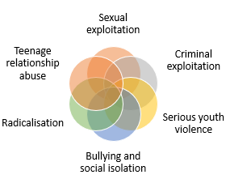
Extra Familial Risk
The term extra familial risk or harm refers to adverse experiences that children or young person experience beyond their family or home environment.
Children are often at greatest risk of extra familial harm during adolescence because at this age their social networks widen and they naturally start to spend more time away from their families and home.
Traditional approaches to child protection have focussed on risk of violence and abuse from within the home; usually from a parent/carer or other trusted adult.
Recognising and responding to extra familial risks is an essential part of safeguarding adolescents.
Young people’s experiences of extra-familial abuse can undermine parent-child relationships
Tackling extra familial risk and harm requires a different approach
Navigation Bar – Click on the icons to find out more
Home
About
Extra Familial Risk
Contextual
Safeguarding
Watch, Listen
& Read
Strategic
Governance
Tactical Delivery
Take Action
Resource
Library
Advice & Support

Slide 4
Extra-familial risk and harm includes:
Sexual exploitation
Criminal exploitation
Serious youth violence
Bullying and social isolation
Radicalisation
Teenage relationship abuse
Hover over each category of harm to read a short definition
Click here to go back to previous page

Slide 5
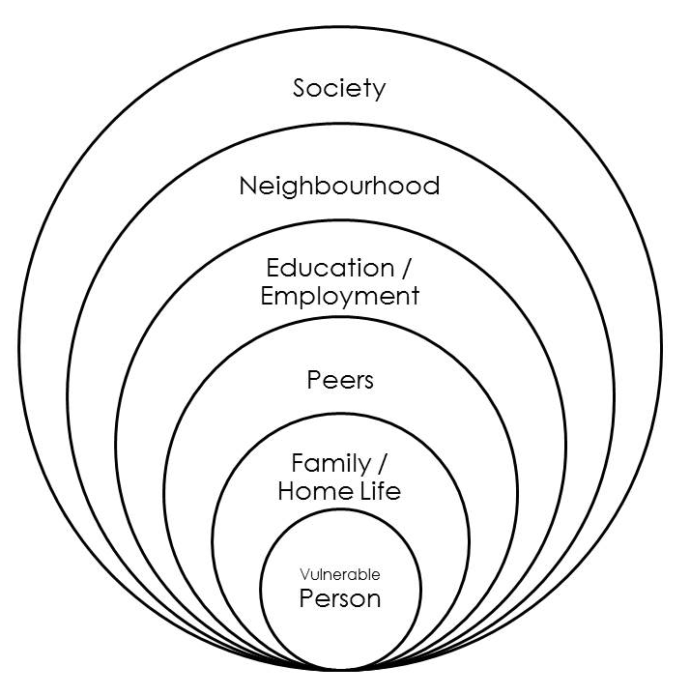
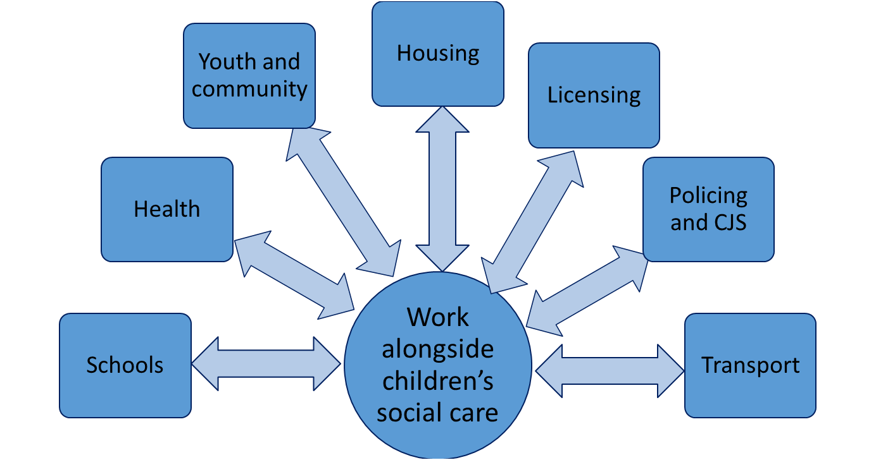
Contextual Safeguarding
Contextual Safeguarding is an approach to understanding and responding to young people’s experiences of extra familial risk and harm; expanding the objectives of child protection systems in recognition that young people are vulnerable to abuse beyond their front doors.
Extra-familial forms of harm are highly contextual. Firmin’s contextual circles help visualise what we mean by different contexts.
A Contextual Safeguarding system will look beyond a parents’ capacity to safeguard to consider who else could intervene to help create safe spaces and wellbeing.
Effective Contextual Safeguarding systems intervene with harmful extra-familial contexts to reduce risk of harm. In order to be effective, all four domains need to be present:
LEGISLATION
PARTNERSHIPS
OUTCOME MEASURES
TARGET Prevent, Identify, Assess & Intervene with the social conditions of abuse | Incorporate context into child protection frameworks. | Work with sectors & individuals who have responsibility or influence over extra-familial contexts | Monitor outcomes for success in relation to contextual, as well as individual change
Navigation Bar – Click on the icons to find out more
Home
About
Extra Familial Risk
Contextual
Safeguarding
Watch, Listen
& Read
Strategic
Governance
Tactical Delivery
Take Action
Resource
Library
Advice & Support

Slide 6
A Contextual Safeguarding system will look beyond parental capacity to safeguard to consider and assess risk and vulnerability in the places and spaces that young people spend their time; taking into account who they are with and what they are doing.
Peer Group
Home
Child
School
Neighbourhood
Whose capacity to safeguard, in which space?
AND
Which space is impacting on which service’s capacity?
Firmin et al. 2016
Click here to go back to previous page
Notes:
So, with this understanding of the kinds of things young people experience and the limitations of the existing systems, it is interesting and useful to consider capacity to safeguard and who else could have an influence???

Slide 7
Within a Contextual system; ‘everyone’s responsibility to safeguard’ means working together with those who have greatest influence to create safety and wellbeing in the places and spaces (including peer groups) in which young people spend their time.
Work alongside children’s social care
Schools
Policing and CJS
Transport
Health
Youth and community
Housing
Licensing
Click here to go back to previous page

Slide 8
In order for a system to be contextual, all four domains of Contextual Safeguarding need to be present and demonstrable:
Domain 1: Target
Seeks to prevent, identify, assess and intervene with the social conditions of abuse
Domain 2: Legislative framework
Incorporate extra-familial contexts into child protection frameworks
Domain 3: Partnerships
Develop partnerships with sectors/individuals who are responsible for the nature of extra-familial contexts
Domain 4: Outcomes measurement
Monitor outcomes of success in relation to contextual, as well as individual, change
(Firmin et al. 2016)
Click here to go back to previous page
Notes:
10 minutes

Slide 9
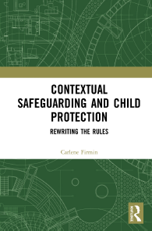
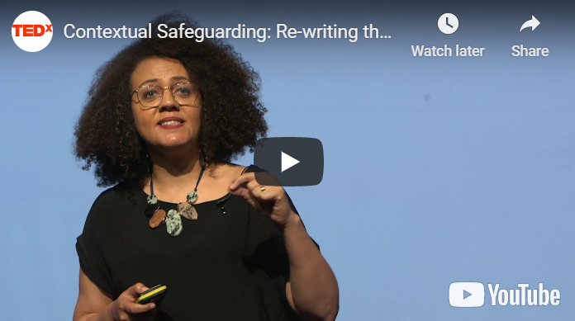
Watch, listen & read all about it!
Here are a small selection of videos and reading materials produced by the University of Bedfordshire & Contextual Safeguarding Network to provide further opportunities and explore some of the topics covered in this resource pack. Additional national and local resources are listed within the library section of this pack.
Short video by University of Beds introducing the concept of Contextual Safeguarding:
Animation describing the Principles of Contextual Safeguarding by the Contextual Safeguarding Network
Dr Carlene Firmin’s 2019 TedX talk on Re-writing The Rules Of Child Protection
Contextual Safeguarding & Child Protection
Dr Carlene Firmin 2020
Navigation Bar – Click on the icons to find out more
Home
About
Extra Familial Risk
Contextual
Safeguarding
Watch, Listen
& Read
Strategic
Governance
Tactical Delivery
Take Action
Resource
Library
Advice & Support

Slide 10
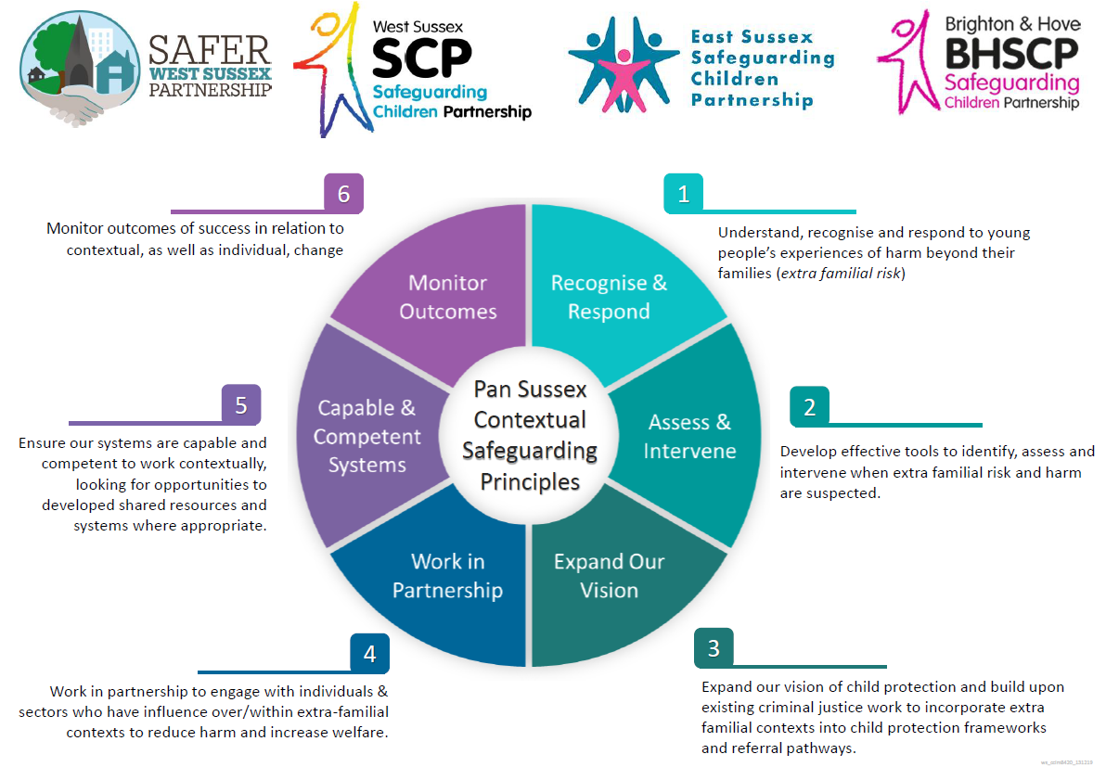
Contextual Safeguarding: Local Strategic Governance
The University of Bedfordshire created the National Area Implementation Group (IAG) to develop, test and review Contextual Safeguarding principles and resources to advance the approach. West Sussex is one of 32 local authorities across England & Wales chosen to be a member of the IAG.
6 strategic Contextual Safeguarding principles have been agreed by partners across Sussex to steer the strategic development of contextual safeguarding within each authority area:
In West Sussex; the strategic development of Contextual Safeguarding (from theory to practice) is governed by the Contextual Safeguarding Steering Group.
Formed of representatives from various WSCC services, District & Borough councils, Sussex Police, NHS, Criminal Justice Services, Schools & specialist service providers, the group drives the development of locality based safeguarding where context is recognised and assessed to help create safety & wellbeing.
Contextual Safeguarding is a new way of working for some; nevertheless there is multi-agency appetite and ambition to work contextually which we will build upon.
Navigation Bar – Click on the icons to find out more
Home
About
Extra Familial Risk
Contextual
Safeguarding
Watch, Listen
& Read
Strategic
Governance
Tactical Delivery
Take Action
Resource
Library
Advice & Support

Slide 11
Click here to go back to previous page

Slide 12
Contextual Safeguarding: Local Tactical Delivery
Contextual Safeguarding compliments existing child protection practices including professional curiosity & signs of safety.
District & Borough community safety & safeguarding teams have lead work to embed contextual responses to place-based risk & low-level group vulnerability.
Click on the agency links to access more specific information and guidance relevant to your area of work
The approach provides social work practitioners with a framework to manage extra familial risk and harm at all levels.
Multi-agency problem solving groups called Peer Group Conferences have been set up in most localities to target areas of concern and group level vulnerability that sits outside complex safeguarding.
Education
Policing & Criminal Justice
Children’s Services
District & Borough Councils
Health
Community & Voluntary Sector
Navigation Bar – Click on the icons to find out more
Home
About
Extra Familial Risk
Contextual
Safeguarding
Watch, Listen
& Read
Strategic
Governance
Tactical Delivery
Take Action
Resource
Library
Advice & Support

Slide 13
Contextual Safeguarding & Children’s Services
Traditional approaches to protecting children and young people from harm have focussed on the risk of violence and abuse from inside the home (usually from a parent/carer or other trusted adult) and therefore don’t always address the time that adolescents spend outside the home and the influence of peers on their development and safety.
Crucial to the success of Contextual Safeguarding is the ability for social workers & practitioners to work with a broad range of partners across agencies and sectors to safeguard and protect children.
Embedding Contextual Safeguarding at the front door
Bringing context into assessment
Developing and implementing contextual safeguarding practice is recognised as a priority within the West Sussex Council Children’s First Improvement Plan
Contextualising Case Management Systems
Interventions Catalogue
Contextual safeguarding expands child protection systems in recognition that adolescents are vulnerable to abuse in a range of social contexts outside the home.
The boxes (right) link to more specific information and guidance about contextual safeguarding for practitioners working with children & young people
Practice Guides
Webinars
Click here to go back to previous page

Slide 14
Contextual Safeguarding & District/Borough Councils
Contextual Safeguarding focuses on creating safety and wellbeing in the spaces and places that young people spend their time.
Aside from the work of CSPs & PGCs, local councils operate many services requiring operatives to spend time within the community. Officers might notice suspicious activity & can provide vital community intelligence.
Thinking contextually can be tricky if safeguarding isn’t a traditional part of someone’s role and they don’t know what to look for.
To help; Madeleine Tester has produced some key contextual questions for district & borough council departments to consider. Click on the boxes (right) to view the relevant team page:
Parks / Foreshore & Community Wardens
Outreach
Well established Community Safety and Safeguarding partnerships (CSP) already address place-based harm. Contextual Safeguarding is an extension of the strong partnership work driven by D&B’s
Licensing
ASB Teams
In West Sussex, D&B Contextual Safeguarding multi-agency problem solving groups called Peer Group Conferences (PGC) have been set up in most localities.
Housing
Waste Management
Click here to go back to previous page

Slide 15
Parks / Foreshore & Community Wardens
Have you noticed seeing the same young people in the same places? What are they doing?
Are you aware of any key locations where young people gather?
What are young people doing in these locations? Who are they with and how did they get there?
Are you seeing any ‘unusual’ relationships forming? E.g. adults who are clearly not related, spending time with groups of young people.
Have you, or police, found any weapons hidden in the park / along the foreshore or other public places?
Have you seen an increase in litter? E.g. broken glass, alcohol bottles, food and drink rubbish, and drug litter.
How often are you/your colleagues in the park?
Days per week
Hours per week
Time of day
Number of staff in the location at any one time
Do other park / foreshore users report any concerns to you? What do you do with these reports?
Do you feel confident in reporting anything concerning you see?
Click here to go back to previous page

Slide 16
Outreach Services & Practitioners
Whilst on Outreach, do you ever see groups of young people congregating?
What are the young people doing in these locations? Why do you think they are drawn to this particular area?
Are you seeing any ‘unusual’ or high risk relationships forming? E.g. adults who are clearly not related spending time with groups of young people, or young people being abusive or hostile to members of the street community?
Have you seen an increase in litter? E.g. broken glass, alcohol bottles, food and drink rubbish, cigarette and drug litter.
How often are you/your colleagues on Outreach?
Days per week
Hours per week
Time of day
Number of staff in the location at any one time
Do members of the street community ever mention concerns they have about young people they may have seen in the community?
Do other members of the community ever report any concerns about young people to you?
Click here to go back to previous page

Slide 17
Licensing Teams
Are you aware of any key locations with licenses where young people congregate or spend time?
Are there open community spaces near to any of these key locations where young people might congregate and/or approach adults to buy alcohol/cigarettes for them?
Have taxi operators mentioned any suspicious activity? E.g taxis being prepaid by adults to collect and transport unaccompanied young people?
Have any concerns been raised about young people spending time at hotels without their parents?
Have you received any reports of young people spending time in/around licensed (and off-licensed) premises?
How often do you check your licensed premises?
Do premises report concerns about young people? E.g. underage clients, alcohol misuse, drug taking.
Do you provide training or information to licensees about child exploitation?
Click here to go back to previous page

Slide 18
Anti Social Behaviour Teams
Do you get reports about groups of young people congregating?
Are young people drawn to particular areas within your locality? What are they doing in these locations? Why do you think they are drawn there?
Are you seeing or hearing about any ‘unusual’ or high risk relationships forming? E.g. adults who are clearly not related spending time with groups of young people, or young people being abusive or hostile to members of the street community?
Do you know the places and spaces young people feel safe or unsafe?
Does your team consider young people troublesome or troubling?
Are vulnerable children linked to problematic properties or adults known to your team?
Click here to go back to previous page

Slide 19
Housing Teams
Are you aware of any vulnerable young people who have approached you for housing?
Do other young people of a similar age live in or visit this housing? What are their vulnerabilities?
Are there communal areas where young people could gather?
Has there been an increase in litter since the young person moved in? E.g. drug litter, broken glass, alcohol bottles, food and drink rubbish.
How often is the accommodation inspected?
How often do you check-in with the young person/tenant?
What are the vulnerability factors for the young person?
Will any vulnerabilities be at risk of worsening in the proposed accommodation?
Do you know the most important relationships in the young person’s life?
Do other residents in the area report any concerns?
Click here to go back to previous page

Slide 20
Waste Management Teams
Have you seen an increase in litter? E.g. broken glass, alcohol bottles, food and drink rubbish, cigarette and drug litter (including small cannisters & balloons), condoms/wrappers
Have you found any weapons?
Have you noticed children or young people hanging around certain locations or places?
Is there a mechanism for you to report suspicious sightings or incidents of concern?
Would you feel confident in reporting anything concerning you see?
Click here to go back to previous page

Slide 21
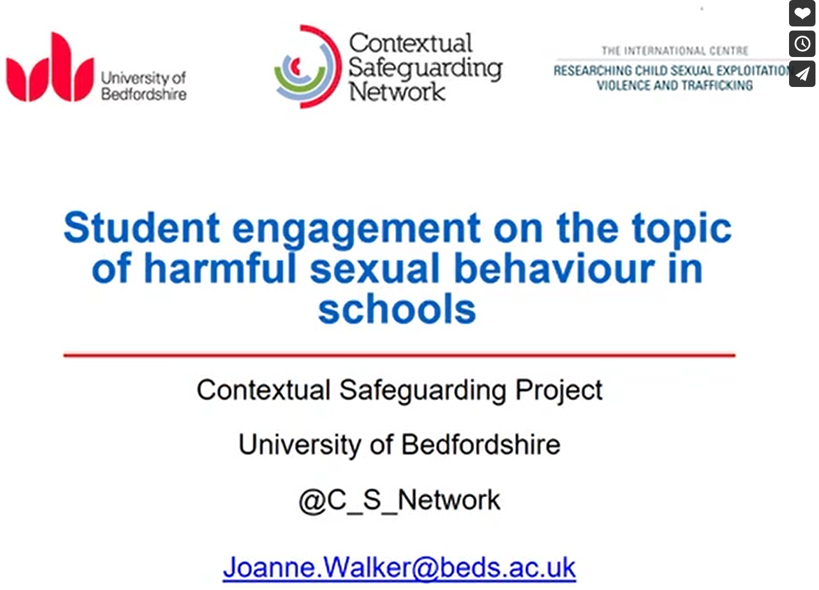
Contextual Safeguarding & Schools
Schools are a significant partner in tackling extra familial risk and harm.
Contextual Safeguarding is referenced within Keeping Children Safe In Education 2018 guidance:
“[Risk] assessments of children should consider whether wider environmental factors are present in a child’s life, that are a threat to their safety”
Recognising the impact of the spaces and places young people spend their time, who they are with and what they are doing is a vital part of the school’s contribution to Contextual Safeguarding.
Contextual safeguarding practice is an extension of the work settings already undertake to promote safety and wellbeing across the whole school community. It complements the Education for Safeguarding (E4S) ethos as the West Sussex way to embed relationships, sex & health education in school
Contextual safeguarding in schools means:
Understanding risks to pupils in the neighbourhoods and spaces they spend their time.
Considering the role of the school in creating safe spaces for young people
Considering community context and drawing upon sources of contextual data when undertaking curriculum development; especially in relation to RSE and PSHE
Ensuring all staff understand the importance of recognising and responding to contextual risks
The network webinar series for Schools:
Andrew Hall provides a short summary of Contextual Safeguarding for schools:
Read more about Contextual Safeguarding in Schools:
Safeguarding Network Article
Educare Article
Click here to go back to previous page

Slide 22
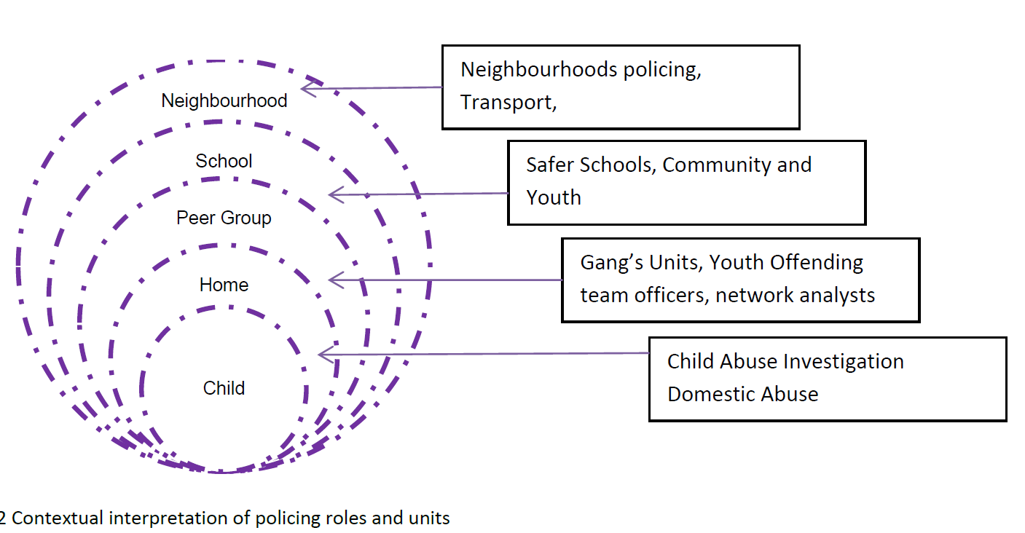
Contextual Safeguarding for Policing & Criminal Justice
Police services are well equipped and have expertise in engaging with most of the contexts associated with extra familial harm. Consequently they are in a prime position to develop contextual practice in both strategic & operational responses to extra familial risk and harm.
The interpretation of policing roles and units is depicted (above) against Firmin’s contextual circles which are often used to symbolise Contextual Safeguarding.
When harm occurs beyond family homes and relationships; children are more readily identified as both being victimised and victimising others.
Children may find themselves perpetrating harmful, violent and sometimes criminal acts to survive or navigate extra-familial contexts in which they have also been abused.
Contextual Safeguarding practice within criminal justice organisations is acknowledged within Working Together to Safeguard Children (2018) “YOTs are well placed to identify children and the contexts in which they may be vulnerable to abuse” (Chp 2, parah 41-9)
For more information; click on the boxes below
Youth Justice Report
Emerging Implications for Policing Webinar
In practice; where children have committed offences in the context of extra-familial harm, plans have historically focused on intervening with the child to bring about change. In a contextual system, practitioners would intervene to change the extra-familial context(s) in which the young person committed offences and/or were harmed. Doing so creates safer spaces for all young people.
College of Policing Briefing
Warning Signs of Extra Familial Risk & Harm
Click here to go back to previous page

Slide 23
Warning Signs of Extra Familial Harm (ABC)
Children and young people affected by extra familial harm are unlikely to disclose their abuse. However they may display visual cues and non-verbal warning signs. These can be categorised as worrying changes to Appearance, Behaviour & Communication (ABC).; some of which you might observe:
APPEARANCE
Suddenly changes their dress or music, including restricting their clothes to a certain colour or style associated with gang culture/religious group.
Looks tired or unwell, unable to pay attention
Marks or scars on their body, which they try to hide.
Injury to hands, necks, legs, buttocks or genitals
Wearing a lot more make-up, appearing ‘overly’ made up or hiding their face with make-up and hair
Unable to make or hold eye contact
BEHAVIOUR
Particularly secretive or has really sharp, severe mood swings.
Develops relationships with older men and/or women or change in peer group
Missing from home / reluctant to say where they have been or what they have been doing.
Appears overly stressed or anxious; especially after phone calls
New/expensive items that they couldn’t legitimately afford
Aggressive or disruptive conduct out of the ordinary.
Self-harm – e.g. cutting or eating disorder
COMMUNICATION
Starts using a different 'street language' or name.
Sudden change in the way they communicate with you e.g. becoming very withdrawn, no longer talking to you about themselves or being very angry / aggressive
Receiving excessive amount of text messages or phone calls- having to keep their phone with them at all times
Talking about new religions or socio-political issues more than usually would
Click here to go back to previous page

Slide 24
Contextual interpretation of policing roles & units
Click here to go back to previous page

Slide 25
Contextual Safeguarding & Health
Health professionals will often work with young people affected by extra familial harm, therefore are important partners for recognising risk and connecting adolescents & incidents.
Health professionals are represented on the Sussex Contextual Safeguarding Development Group, West Sussex Contextual Safeguarding Steering Group and West Sussex Champions by Sussex clinical commissioning groups.
Safeguarding is at the heart of the national health system, however contextual practice is still developing. Click on the boxes below to access key questions and indicators of harm together with more specific guidance for practitioners looking to adopt contextual safeguarding into their practice:
Young people experiencing extra familial harm might exhibit a range of health indicators; including
Physical health needs E.g sexually transmitted infections, non -accidental injuries and/or self harm
Poor emotional & mental well-being
Aggressive or threatening behaviour
Unwillingness to trust and engage with adults (especially those in positions of authority)
Key Questions to Consider
Extra Familial Harm Indicators
Contextual Practices
NHS England Safeguarding Annual Update Report
Click here to go back to previous page

Slide 26
Would you/your staff feel confident & competent to identify potential victims of extra familial harm?
HEALTH VISITORS - Do you have any very young patients or patients who you are particularly worried about? Have your patients ever appeared nervous or intimidated? Could there be issues such as extra-familial harm affecting them?
SEXUAL HEALTH – Have you noticed clusters of young people presenting with similar symptoms? or very young females requesting contraceptive implants, patients seeking emergency contraception or young people being bought to clinics either by taxis or older people they don’t seem related to? Do you patients ever talk to you about suspicious circumstances?
SCHOOL NURSES – Are you aware of specific places or groups young people ‘hang out’ with? Do they spend their time with significantly older people, or excessive amounts of time online? Do they normalise risk taking behaviours? Have pupils disclosed health concerns linked with extra familial risk and harm? Have you noticed any areas of the school that pupils seem afraid or avoid? Is there a culture of violence or misogyny in school? Are sexualised behaviours normalised? E.g bra-pinging, up-skirting, sexting, sexualised conversations
MENTAL HEALTH TEAMS - Have your patients talked about places or groups they ‘hang out’ with? Do they spend their time with significantly older people, or excessive amounts of time online? Do they normalise risk taking behaviours?
A&E – Have you noticed young people attending with suspected non-accidental injuries (burns, lacerations, stab wounds, self-inflicted injuries, anal injuries linked to plugging drugs) or have there been any notable clusters of, or changes in A&E attendances among young people? Would you be able to link cases if multiple patients attended with similar injuries or complaints?
GP’s & NURSE PRACTITIONERS & PHARMACIES – Have you noticed clusters in young people presenting with similar symptoms? or very young females requesting contraceptive implants, patients seeking emergency contraception?
ACUTE HOSPITAL (IN-PATIENTS) – Have you noticed an increase in young people admitted with similar, worrying symptoms? Or an increase in serious injuries to young people involving weapons? Have you had patients who have been sexually assaulted (including anal injuries associated with plugging drugs) but claim they are in a relationship with the assailant/the injury was accidental?
SPECIALIST CLINICS – Have you noticed a change in the number or circumstances of patients that might indicate they are at risk of extra familial harm? (E.g increase in females seeking terminations, spates of young patients presenting for treatment at GUM clinics, anal injuries associated with plugging drugs)
SUBSTANCE MISUSE SERVICES – Have you noticed an increase or change in cohort of young service users? Has there been any changes in the substances young people are using and is this linked to other worrying indicators of extra familial risk/harm? Have you ever noticed young people being bought to clinics either by taxis or older people they don’t seem related to? Do you patients ever talk to you about suspicious circumstances or feelings like they have no choice?
Click here to go back to previous page

Slide 27
Warning Signs of Extra Familial Harm (ABC)
Children and young people affected by extra familial harm are unlikely to disclose their abuse. However they may display visual cues and non-verbal warning signs. These can be categorised as worrying changes to Appearance, Behaviour & Communication (ABC).; some of which you might observe:
APPEARANCE
Suddenly changes their dress or music, including restricting their clothes to a certain colour or style associated with gang culture/religious group.
Looks tired or unwell, unable to pay attention
Marks or scars on their body, which they try to hide.
Injury to hands, necks, legs, buttocks or genitals
Wearing a lot more make-up, appearing ‘overly’ made up or hiding their face with make-up and hair
Unable to make or hold eye contact
BEHAVIOUR
Particularly secretive or has really sharp, severe mood swings.
Develops relationships with older men and/or women or change in peer group
Missing from home / reluctant to say where they have been or what they have been doing.
Appears overly stressed or anxious; especially after phone calls
New/expensive items that they couldn’t legitimately afford
Aggressive or disruptive conduct out of the ordinary.
Self-harm – e.g. cutting or eating disorder
COMMUNICATION
Starts using a different 'street language' or name.
Sudden change in the way they communicate with you e.g. becoming very withdrawn, no longer talking to you about themselves or being very angry / aggressive
Receiving excessive amount of text messages or phone calls- having to keep their phone with them at all times
Talking about new religions or socio-political issues more than usually would
Click here to go back to previous page

Slide 28
Contextual Practice for Health Professionals
Contextual safeguarding looks at how we can best professionals can identify and understand extra familial risks; engage with children and young people and help to keep them safe. The approach focuses on considering context: the places and spaces young people spend their time; who they are with and what they are doing. Using this contextual knowledge, practitioners can assess who is best placed to intervene with the context to create safety and wellbeing.
“All staff who come into contact with children and young people have a responsibility to safeguard and promote their welfare and should know what to do if they have concerns about safeguarding/child protection issues”. Intercollegiate document
Intercollegiate guidance, together with local safeguarding policies and procedures set out your organisation's commitment to protecting children and young people. National NHS safeguarding policy references Contextual Safeguarding as an appropriate response to identifying and assessing extra familial risk in children and young people.
In practice, when applying contextual safeguarding in practice, this simply means adopting a common-sensical approach to the situation and thinking about all the aspects of a persons’ life and how they might impact on their feelings of safety and wellbeing. In the case of identifying and managing risks associated with extra familial risk and harm, this means questioning what you see, are told and know about a patient and exercising professional curiosity in order to establish the places and spaces they feel safe or unsafe and whether there are particular contextual safeguarding needs?
Click on this box to read a contextual safeguarding case study
Click here to go back to previous page

Slide 29
A secondary school age female patient presents to sexual health services for emergency contraception during school hours but complains of some vaginal discomfort.
During examination the practitioner notices the patient has an untreated STi that is similar to another case the practitioner treated the previous week.
When the practitioner gently asks the patient about their sexual history, they are unwilling to disclose any information and appear anxious.
The receptionist later commented to the practitioner that the female arrived unaccompanied at the clinic by taxi but didn’t appear to have any money or personal possessions with her.
The reception commented that she felt it was odd, but didn’t say anything to the female because she had noticed a few taxi’s dropping girls off, so it seemed quite commonplace these days.
Would you consider this to be a contextual safeguarding issue? Would the taxi, non school attendance and young female travelling unaccompanied trigger concerns?
How might you report contextual concerns? Who would you tell? Are your Safeguarding procedures capable of capturing contextual concerns? What could you do? Would you record details of the taxi? Link with symptoms/injuries with other similar cases? Make a MASH referral? …what if the young person attended anonymously or gave false details?
Click here to go back to previous page

Slide 30
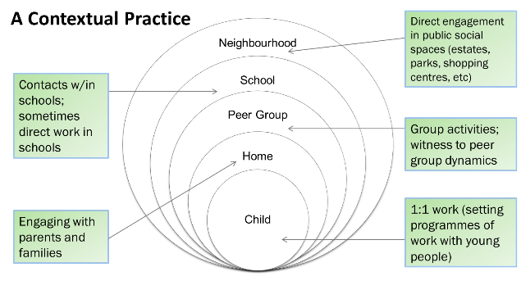
Contextual Safeguarding & the Community & Voluntary Sector
Voluntary and community organisations are perfectly placed to incorporate contextual safeguarding when working with children and young people. The approach may feel like common sense, or a natural extension to the youth work already being carried out. Many practitioners naturally include elements of Contextual Safeguarding practice without realising.
You know your local community and the young people you work with, so keep your eyes and ears open for changes or anything that is potentially concerning; perhaps in local public spaces such as parks, cafes, bars and shopping areas, or within the services you provide.
NSPCC Blog: Contextual Safeguarding & CVS
By understanding what's happening in the local area and working with others; the Community & Voluntary Sector plays an important role in safeguarding children and young people. Look at all the ways the CVS already supports Contextual Safeguarding
Good contextual safeguarding practice relies upon practitioners building strong and effective partnerships with agencies who have a reach into extra-familial contexts such as the community & voluntary sector
Click here to go back to previous page

Slide 31
Examples of Contextual Practice within the CVS
Click here to go back to previous page

Slide 32
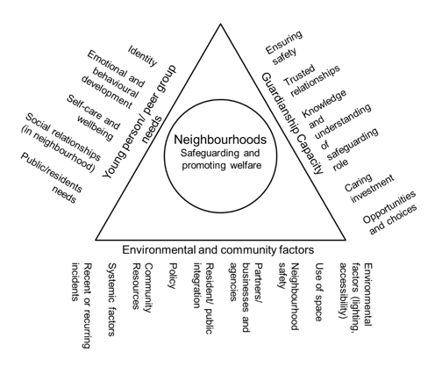
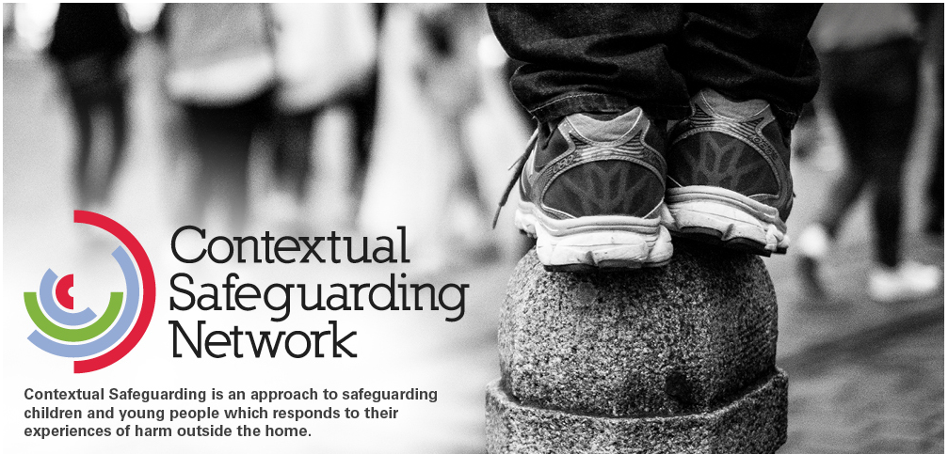
Take Action
To many people, Contextual Safeguarding principles formalise a common sense approach to creating safety and wellbeing. However they can also represent a radically different way of working in practice.
Develop your confidence and competence by watching webinars bought to you by the University of Bedfordshire or access local training
Join the Contextual Safeguarding Network! Click on the picture for a host of information, guidance and resource including blogs & podcasts
Think about & assess the impact of the places and spaces young people spend their time; who they meet & how they spend their time.
Navigation Bar – Click on the icons to find out more
Home
About
Extra Familial Risk
Contextual
Safeguarding
Watch, Listen
& Read
Strategic
Governance
Tactical Delivery
Take Action
Resource
Library
Advice & Support

Slide 33
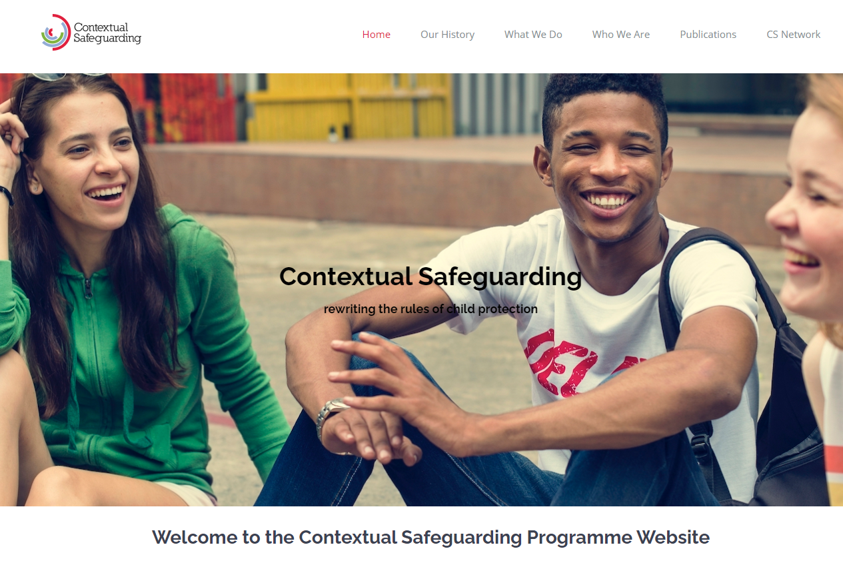
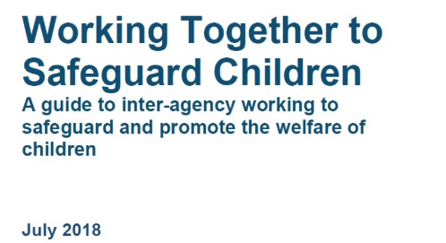
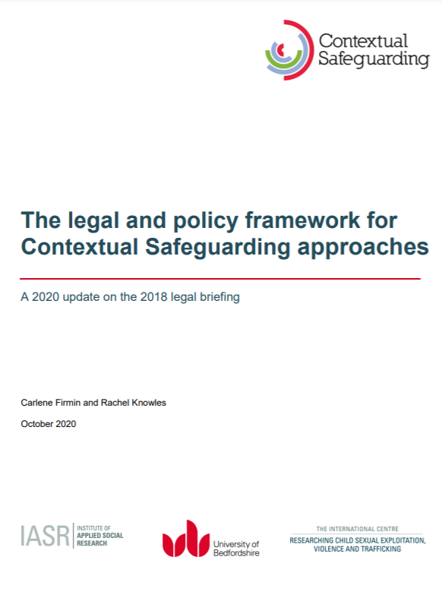
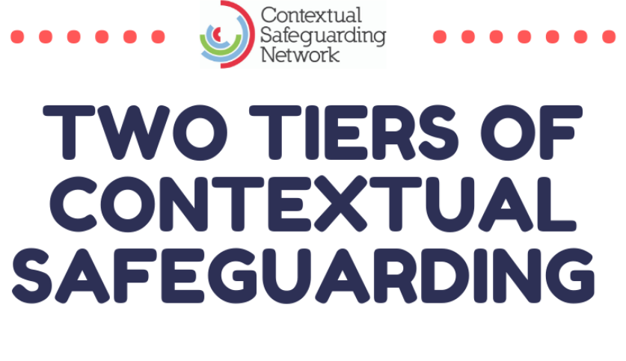
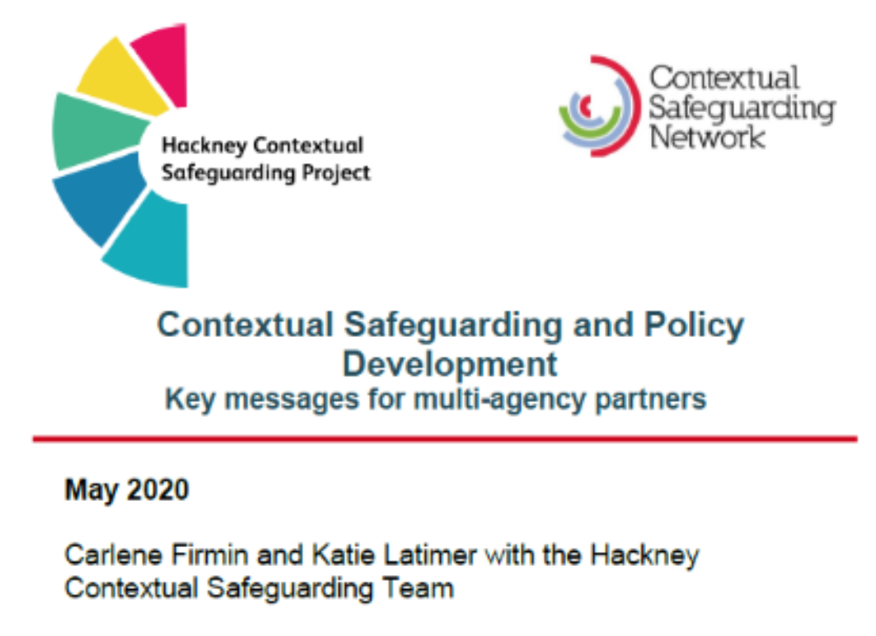
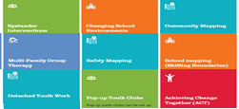
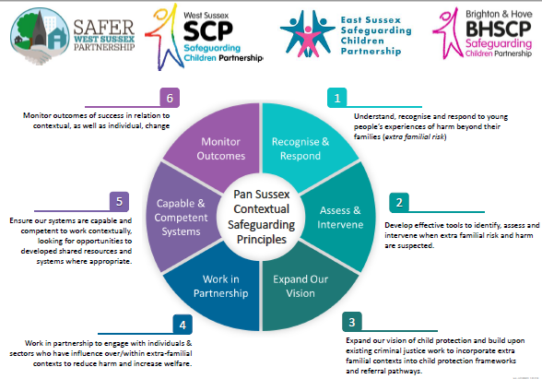
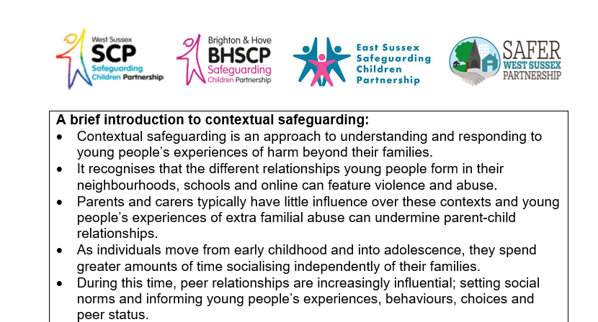
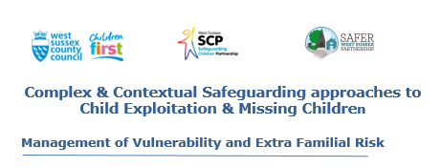
Resource Library
Below is a small selection of videos and reading material providing further opportunities to explore some of the topics covered in this resource pack. Click on the images to view the resources in full.
LEVEL ONE CONTEXTUAL SAFEGUARTDING
LEVEL TWO CONTEXTUAL SAFEGUARTDING
CONTEXTUAL SAFEGUARDING FOR SCHOOLS
INTERVENTIONS CATALOGUE
SUSSEX PRINCIPLES
SUSSEX STARTER PACK
WEST SUSSEX MANAGAEMENT OF RISK FRAMEWORK
West Sussex Toolkit: Operational Delivery Level 2 Contextual Safeguarding
Navigation Bar – Click on the icons to find out more
Home
About
Extra Familial Risk
Contextual
Safeguarding
Watch, Listen
& Read
Strategic
Governance
Tactical Delivery
Take Action
Resource
Library
Advice & Support

Slide 34
Click here to go back to previous page

Slide 35
West Sussex Operational Delivery Toolkit
At Level 2; professionals work contextually to actively change the extra-familial contexts identified as impacting young people and families - peer groups, schools, public spaces can be subject to an assessment, safeguarding meeting or plan. In West Sussex, level 2 Contextual Safeguarding is operationalised via the multi-agency Peer Group Conferences. The following resources have been developed to help stakeholders identify, manage and respond to extra familial risk and harm at level 2.
Peer Group Conference Terms of Reference
Neighbourhood Observations
Neighbourhood Assessments
Park / Open Space Audits
Business Surveys
Trigger Plan Process Flowchart
Trigger Plan Problem Solving Template
Context
Mapping
Click here to go back to previous page

Slide 36
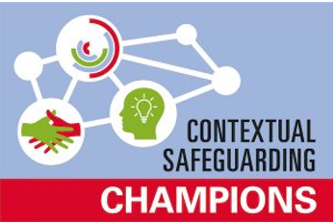
Advice & Support
The Contextual Safeguarding network is a virtual hub bringing together national & international practitioners to share and generate knowledge on contextual approaches to safeguarding young people through theory-informed practice. A wide range of sectors are represented including local authority children & family social care, social work, education, health, community safety, voluntary & community services.
You are encouraged to join the Contextual Safeguarding Network however you can also access local support.
Claire Clilverd is the West Sussex Contextual Safeguarding SPOC providing technical advice & guidance. Authorised by University of Bedfordshire to deliver the national Contextual Safeguarding programme suite of training materials, Claire is also a national Contextual Safeguarding Champion.
Contact the Contextual Safeguarding team or your own agency champion to find out more and to access support available to you.
Access technical help & support from your Contextual Safeguarding Champion:
LEAD CHAMPION & TECHNICAL ADVISOR: Claire Clilverd, Contextual Safeguarding Team, WSCC
WSCC (Children's Services): Henrietta Delalu, Children’s Services
D&B: Sophie Whitehouse, Adur & Worthing Council
SCHOOLS: Jo Neville, The Angmering School
SUSSEX POLICE: Inspector Steve Turner
HEALTH: Sarah Cerioli, West Sussex Clinical Commissioning Groups
Navigation Bar – Click on the icons to find out more
Home
About
Extra Familial Risk
Contextual
Safeguarding
Watch, Listen
& Read
Strategic
Governance
Tactical Delivery
Take Action
Resource
Library
Advice & Support

Slide 37
This pack has been produced by Claire Clilverd, Contextual Safeguarding Lead Professional, West Sussex County Council.
D&B departmental content & delivery toolkit resources provided by Madeleine Tester, Adur & Worthing Councils
The resource pack and information contained within it should be used for personal and team professional development, but must not be used for commercial training purposes. Appropriate ownership of the document and external links contained (inc. University of Bedfordshire & the Contextual Safeguarding Network) must be cited if published on any external webpages or online forum.
The author cannot accept any responsibility for the content in external links which were all verified as accurate at the point of publication.
Initial Publication: December 2020
Copyright WSCC
Navigation Bar – Click on the icons to find out more
Home
About
Extra Familial Risk
Contextual
Safeguarding
Watch, Listen
& Read
Strategic
Governance
Tactical Delivery
Take Action
Resource
Library
Advice & Support

